Slide 1
Three level schema architecture (ANSI SPARC),
LECTURE NO 5
5/03/24
BY
Ayesha jarral

Slide 2
Introduction
The three-level schema (structure) architecture, as defined by ANSI SPARC, is a framework for organizing and managing databases. It divides the database system into three levels of abstraction, each serving a distinct purpose:
Notes:
What is the structure to store data

Slide 3
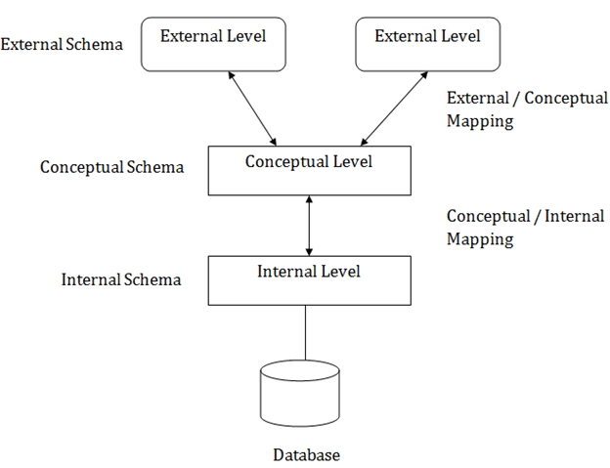
Levels of schema
External level
Conceptual level
Internal level

Slide 4
External level
Explanation: The external level is how users interact with the database. It's like the interface or view that users see and use to access the data they need.
Daily Life Example: Think of a music streaming app where users have different interfaces based on their preferences. Some users might see personalized playlists, while others see recommended songs based on their listening history.

Slide 5
Conceptual level
Explanation: The conceptual level is the overall structure of the database, which provides a unified view of the entire database. It defines how the data is organized and related to each other, without worrying about how it's stored.
Daily Life Example: Consider a library catalog where books are organized by genre, author, and subject. Users can search for books based on these categories without knowing how the books are physically stored on shelves.

Slide 6
Internal level
Explanation: The internal level is how the data is physically stored and managed within the database system. It includes details like storage structures, access methods, and optimization techniques.
Daily Life Example: Imagine a warehouse where items are stored in different aisles, shelves, and bins. The warehouse manager decides how items are organized and accessed efficiently, without customers needing to know the exact layout of the warehouse.

Slide 7
Summary
summary, the three-level schema architecture provides a way to separate the user's view of the data (external level), the logical organization of the data (conceptual level), and the physical storage details (internal level). This separation helps in managing complex databases effectively and allows for changes to be made at each level without affecting the others.
n n

